Slide 1



NETWORK SECURITY
FIREWALL

Slide 2
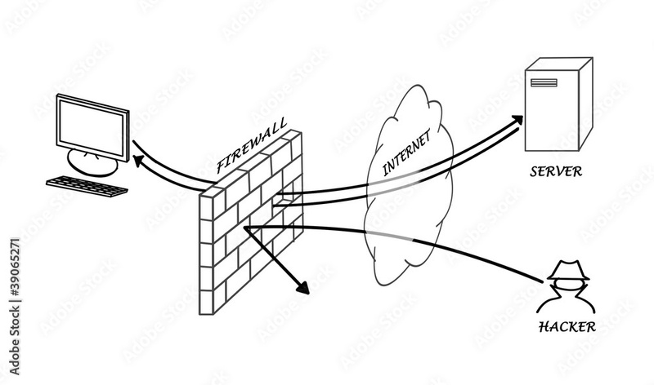
FIREWALL
Network security tools called firewalls keep an eye on and regulate all incoming and outgoing network traffic . They serve as a line of defence against unwanted access and filter harmful traffic, standing between a secured network and the outside world .

Slide 3
STUDIO SHODWE
FUNCTIONS
PACKET FILTERING
STATEFUL INSPECTION
01
02
PROXYING
VPN SUPPORT
03
04

Slide 4

ADVANTAGES
DISADVANTAGES
NETWORK SECURITY
OVERHEAD AND PERFORMANCE
ACCESS CONTROL
COMPLEX CONFIGURATION
PROTECTION
SINGLE POINT OF FAILURE
BLOCKING LEGISTIMATE SERVICES
VPN SUPPORT

Slide 5

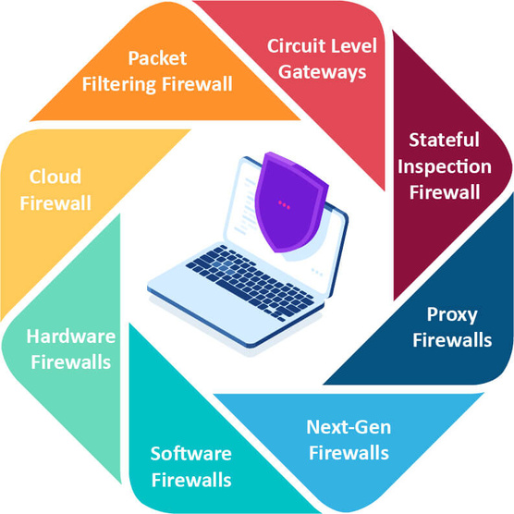
TYPES OF FIREWALLS
TRADITIONAL
FIREWALL
WEB
APPLICATION
APPLICATION
GATEWAY
CIRCULAR
GATEWAY
UNIFIED THREAD
MANAGEMENT

Slide 6
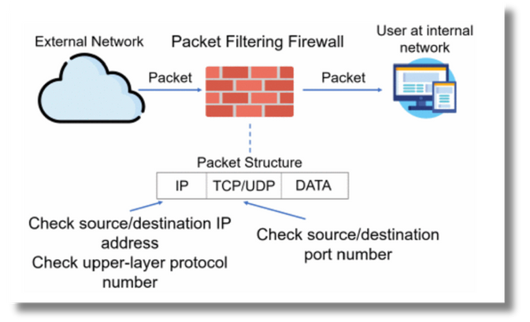
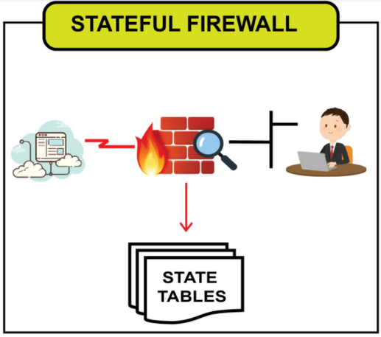
TRADITIONAL FIREWALL
a. Packet Filtering
The first firewall was the packet filtering firewall. By keeping an eye on both incoming and departing packets, it filters packets. It filters them using a set of rules based on the protocols, ports, and Internet Protocol (IP) addresses of the packets
b. Stateful Filtering
Updated packet filtering firewall is known as stateful-firewall. The three-way handshake procedure in TCP serves as the foundation for its operation. With stateful firewalling, all packets inside the traffic flow in both directions are tracked, as well as established flows. Based on the header data of this traffic, including IP addresses and port numbers, a profile is generated for each new connection that enters a syn-packet in a TCP flow. The stateful firewall compares each subsequently attempted connection to this list of records. The packet is permitted to flow across the firewall if the connection is indeed present in the cache.

Slide 7
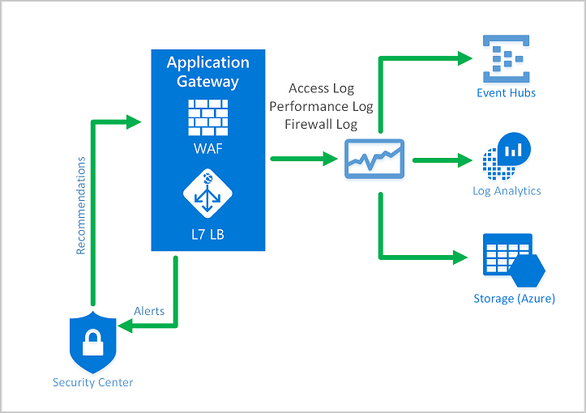
2. APPLICATION GATEWAY FIREWALL
Network traffic can be controlled at the application level with an application-gateway firewall. An application-gateway firewall is no longer a "wall" positioned between a traffic source and its destination. It functions more like to a "gateway," one that establishes sessions with distant users via proxies and inspects incoming packets at the application level. Every time a client attempts to access a server's network resources, a secure gateway is formed. Every network resource that enters from the server first passes via the gateway before, upon request, being returned to the client

Slide 8
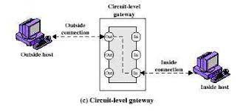
3. CIRCULAR GATEWAY FIREWALL
A circuit-gateway firewall functions as a "gateway" between the client and the server, much like an application-gateway firewall. Circuit-gateway firewalls don't function at the application layer, in contrast to application-gateway firewalls. Rather, it functions at the session layer. The circuit-gateway firewall concentrates on the connections between the client and server rather than the network resources of the server. a circuit-gateway firewall offers a proxy that establishes a transparent connection known as a virtual circuit that serves as an end-to-end link between the client and the server.s. Additionally, it ensures that requests and responses are consistent, meaning that the information coming from the server and the client's request match. There's a possibility that someone is attempting to steal data from the network if the answers do not match the queries.

Slide 9

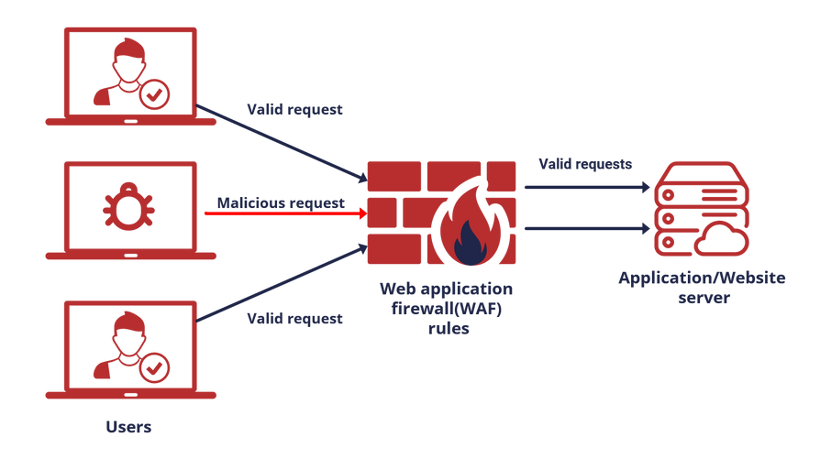
4. WEB APPLICATION FIREWALL
One particular kind of application firewall that is only applicable to web applications is the web-application firewall (WAF). It is a security feature of an application proxy device that guards the web application server on the back end against various attacks. By examining network traffic patterns and HTTP/HTTPS request packets, it safeguards the web server. In the case that any malicious packets or patterns are discovered, WAF stops the assaults by either deleting the client-server session or blocking HTTP requests. However, it is unable to handle zero-day exploits, or vulnerabilities that are not yet known to exist. because pattern recognition is the foundation of a WAF's threat detection system in large part. Because there is no pattern, it is hard for WAF to identify an attack that has never been observed before. As a result, it is challenging to repel them.

Slide 10
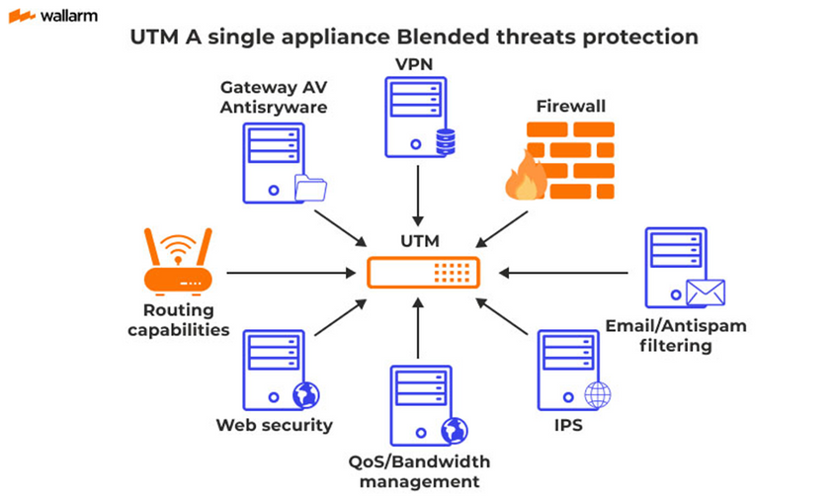
5. UNIFIED THREAD MANAGEMENT FIREWALL
Unified Threat Management (UTM) is a strategy that combines many security features that may handle various cyberthreat kinds into a single software or hardware device. UTM offers a plethora of protection techniques, including rule matching packet filtering, stateful inspection, intrusion detection (or prevention) systems, applications, circuit gateways, and more.

Slide 11

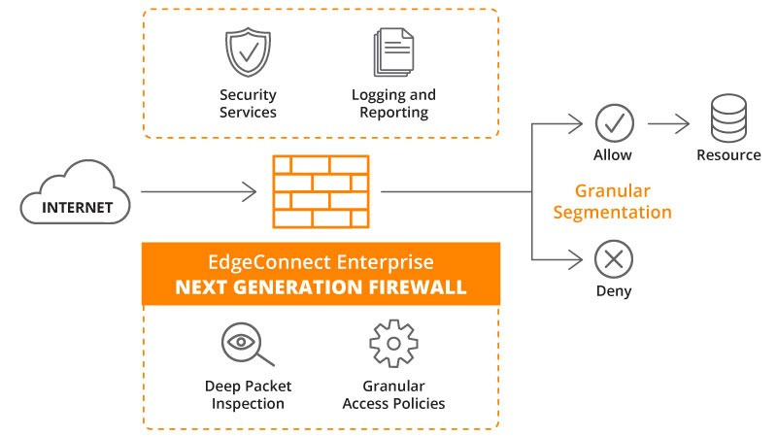
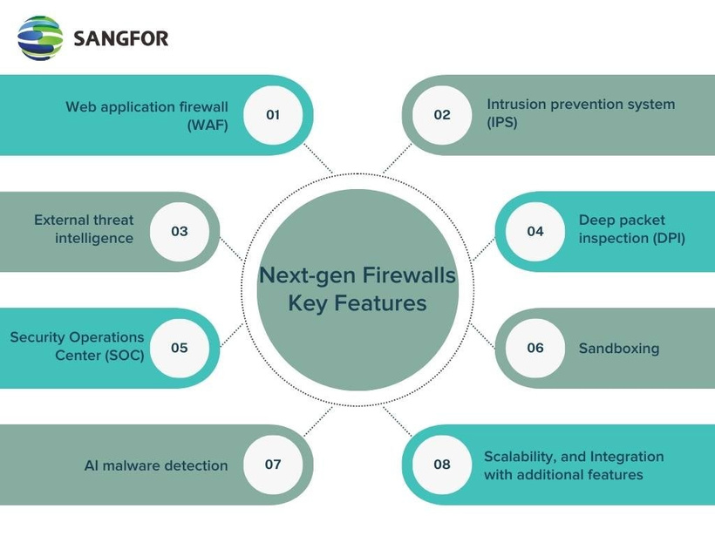
NEXT GENERATION FIREWALL
Next-Generation Firewall (NGFW) was invented around 2009 by Gartner.
It was similar to the UTM Essentially, DPI firewall technology is applied by next-generation firewalls through integration of application intelligence, control, and intrusion prevention systems (IPS) to visualize the content of the data being read and processed.

Slide 12


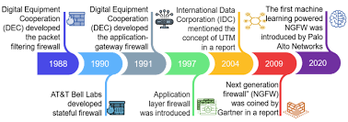
EVOLUTION

Slide 13
APPLICATIONS
Type | Applications
Packet Filtering Firewall | Commonly used in routers and switches.
Stateful Firewall | Commonly used in enterprise networks and Data Centres
Application Gateway Firewall | Commonly used in proxy servers.
Circuit-Level Firewall | Typically used in dial-up connections and older networks.
Web Application Firewall (WAF) | Specifically designed for web applications and websites.
Unified Threat Management (UTM) | Used in comprehensive network security solutions.

Slide 14
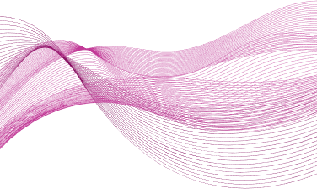
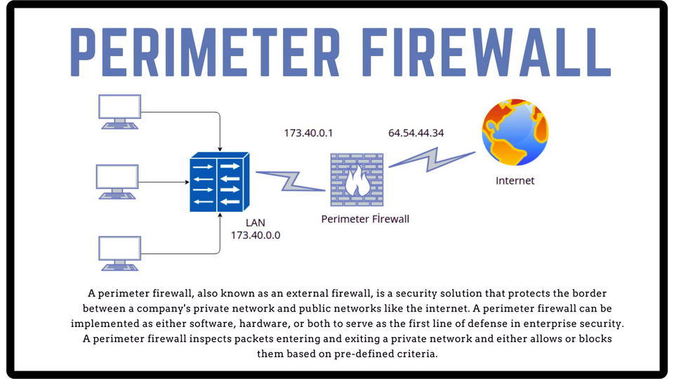
FIREWALL ARCHITECTURE
01
SINGLE PERIMETER FIREWALL
The most basic kind of firewall deployment is a single perimeter firewall architecture. The internal network and the internet are separated by a single firewall.

Slide 15
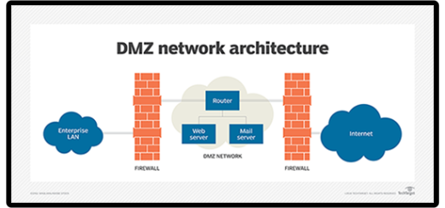
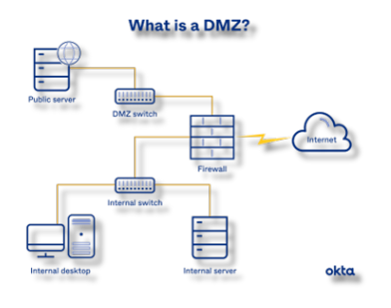
FIREWALL ARCHITECTURE
02
DUAL PERIMETER ( DMZ ) FIREWALL
A demilitarized zone (DMZ) separates the two firewalls that make up a dual perimeter firewall system. A network segment that sits between the internal network and the internet is called the DMZ. It is usually used to host servers, such web servers and email servers, that must be reachable over the internet.

Slide 16
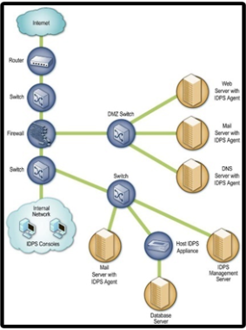
FIREWALL ARCHITECTURE
03
MULTILAYERED SECURITY ( IDS & IPS)
against cyberattacks can be achieved by combining multiple security technologies through the use of multi-layered protection. IDSs and IPSs can be connected with firewalls to offer a more complete defence against online threats

Slide 17
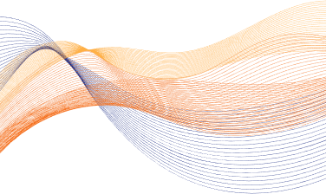
TYPES OF ATTACKS
SYN FLOODING ATTACK
PING OF DEATH ATTACK
IP ADDRESS
SPOOFING ATTACK
SESSION HIJACKING ATTACK
The three TCP session hand shakings are connected to this attack. The two connection endpoints exchange three-way handshakes to start a TCP session. Let us say that host A wishes to attack host B, A transmits SYN packets to B; the source IP address host of these packets cannot be reached. B sends a SYN/ACK packet to the inaccessible address in response. B would thus have to wait an eternity for the unreachable address host to a TCP ACK packet to complete the three-way handshake.
Ping is an echo request packet sent over the Internet Control Message Protocol (ICMP). In order to target the victim server, the attacker impersonates its source address in this attack. The attacker then sends multiple ICMP packets to various destination addresses. Echo request is the most common ICMP message to send. if a specific node is present. Any node receiving these ICMP echo replies is sent to the victim machine rather than the spoofing machine. The victim machine would most likely be unable to carry out any helpful tasks when it received these ICMPs echo replies from numerous nodes.
communication session's two endpoint nodes. Because of where you are, any communication between these two nodes has to go via a node under your direct control. You can generate arbitrary IP traffic and sniff packets on your node by listening to the packets. If you want to trick both nodes into doing what you want, you have to manage both ends of the conversation.
IP spoofing is the most damaging active assault on the Internet since the attacker impersonates an author machine with one machine. Thus, an attacker would interact with a secured site as a legitimate user.The server, inundated with thousands of additional false connection requests, attempts to connect to non-existent servers and waits for a response. As a result of being overloaded with false requests, the server starts to refuse service to actual users.

Slide 18





Case Study: WINDOWS DEFENDER FIREWALL
As a stateful host firewall, Windows Defender Firewall is included
specify which network traffic can enter it from the network and which network traffic it can send there
Internet Protocol security (IPsec) is supported
It offers different profiles with varying levels of security settings

Slide 19
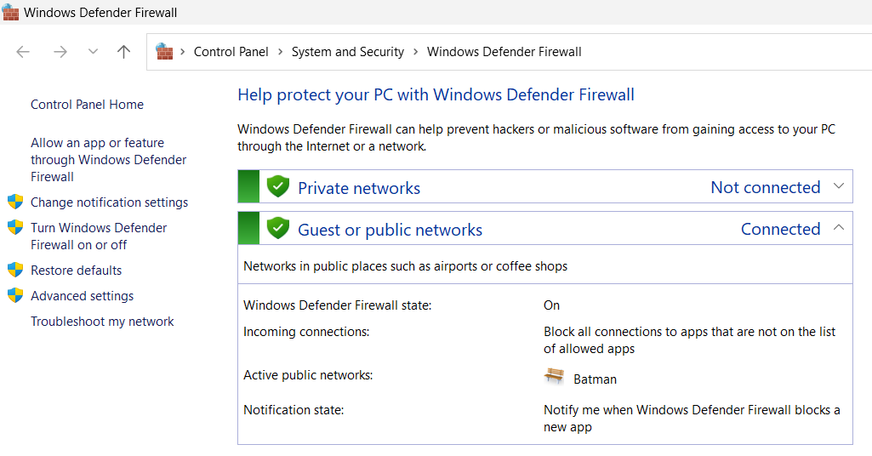
Case Study: WINDOWS DEFENDER FIREWALL

Slide 20


CONCLUSION
an integral role in ensuring overall network security
analyse patterns and behaviours in network traffific enabling the detection of suspicious activities
firewalls prevent unauthorized access attempts and filter out malicious content

